Slide 1


Module 6:
Selenium WebDriver
by Uladzimir Zviartouski
JANUARY 29, 2016

Slide 2


Module 6:
Selenium WebDriver
Lectre 1: WebDriver Basics
JANUARY 29, 2016

Slide 3





FEW WORDS ABOUT ME
5+ years with EPAM
ULADZIMIR ZVIARTOUSKI
Lead Software Testing Engineer

Slide 4
MODULE 6 : AGENDA
1
2
3
Lecture 1
Lecture 2
Lecture 3
Overview: what is WebDriver?
How it works?
WebDriver API
Locators
Synchronization
Specials
Page Object Pattern
Page Factory Pattern
Actions
JavaScript executor
Remote Execution
Selenuim Grid

Slide 5
Part 1
Selenium WebDriver.
What is webdriver?

Slide 6
1. WHAT IS WEBDRIVER? WHAT IS SELENIUM?
Selenium is a project name, within which a series of software products is developed:
Selenium IDE (Firefox plugin, that records and reproduces user actions)
Selenium RC (the previous version of the library for browser management = Selenium )
Selenium Server standalone (lets you control the browser from a remote machine over the network)
Selenium WebDriver (library for browser management)
Selenium Grid (cluster consisting of several Selenium Servers)
Open source project (Apache 2.0 license)

Slide 7

1. WHAT IS WEBDRIVER? SELENIUM HISTORY
Developed by Jason Huggins in 2004 at ThoughtWorks company
In 2004, Paul Hammant joined the team and steered the development of the second mode of operation - Selenium Remote Control (Selenium RC)
In 2005, Dan Fabulich and Nelson Sproul made a series of patches that transformed Selenium-RC into what it became best known for.
In 2007, Huggins joined Google, where he continued with the development and stabilization of Selenium RC
In 2007, Simon Stewart at ThoughtWorks developed WebDriver
In 2008, Philippe Hanrigou (then at ThoughtWorks) made Selenium Grid
In 2009, after a meeting between the developers at the Google Test Automation Conference Google Selenium RC and ThoughtWorks WebDriver projects were merged -> Selenium WebDriver (or Selenium 2.0) was born
Why the name is ‘Selenium’?
Notes:
Mercury is a company that produces interactive testing solutions (Test Director for instance) - and they charge a lot of money for these tools. You can get involved in the forum811: Mercury Interactive Testing solutions for this if you like. Seleniuim is open source - and as such costs you nothing. Selenium, as the chemists amongst you may be aware, is the antidote to Mercury poisoning. In the context of this open source tool, Open QA Selenium is the "antidote" to the commercial Mercury product line.

Slide 8


1. WHAT IS WEBDRIVER? SELENIUM FUTURE – 3.0
Selenium 3.0 – work is in progress..
W3C Working Draft 09 November 2015
WebDriver is a remote control interface that enables introspection and control of user agents. It provides a platform- and language-neutral wire protocol as a way for out-of-process programs to remotely instruct the behaviour of web browsers.
The standard forms part of the Web Testing Activity.
Planned Selenium 3.0 release – end of December 2015!

Slide 9
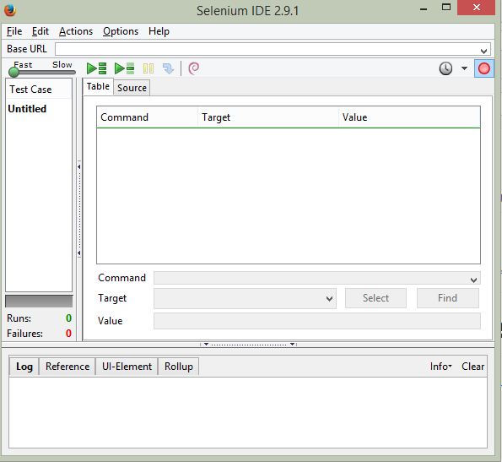

1. WHAT IS WEBDRIVER? SELENIUM IDE
Selenium IDE – Mozilla Firefox extension
http://www.seleniumhq.org/download/
Capabilities:
record and playback simple tests
simple assertions
export generated code
Usually is used for
Selenium automation get stared
Create a small scenario for quick bug replication
Auxiliary script to avoid routine during manual testing
Doesn’t require any programming skills
Has a lot of plugins, that may significantly extend Selenium IDE capabilities

Slide 10
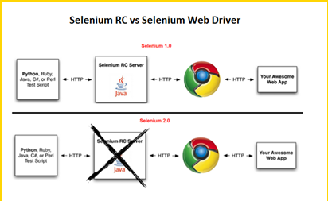
1. SELENIUM WEBDRIVER VS. SELENIUM RC
Selenium RC sends commands to browsers via JavaScript (Selenium Core)
Selenium WebDriver sends commands to browsers using browser native interfaces
Notes:
Scripts may be automatically recorded and edited manually providing autocompletion support and the ability to move commands around quickly. Scripts are recorded in Selenese, a special test scripting language for Selenium. Selenese provides commands for performing actions in a browser (click a link, select an option), and for retrieving data from the resulting pages.
Selenium client API[edit]
As an alternative to writing tests in Selenese, tests can also be written in various programming languages. These tests then communicate with Selenium by calling methods in the Selenium Client API. Selenium currently provides client APIs for Java, C#, Ruby and Python.
With Selenium 2, a new Client API was introduced (with WebDriver as its central component). However, the old API (using class Selenium) is still supported.
Selenium Remote Control[edit]
Selenium Remote Control (RC) is a server, written in Java, that accepts commands for the browser via HTTP. RC makes it possible to write automated tests for a web application in any programming language, which allows for better integration of Selenium in existing unit test frameworks. To make writing tests easier, Selenium project currently provides client drivers for PHP, Python, Ruby, .NET, Perl and Java. The Java driver can also be used with JavaScript (via the Rhino engine). A new instance of selenium RC server is needed to launch html test case - which means that the port should be different for each parallel run.^{[citation needed]} However, for Java/PHP test case only one Selenium RC instance needs to be running continuously.^{[citation needed]}
Selenium Remote Control was a refactoring of Driven Selenium or Selenium B designed by Paul Hammant, credited with Jason as co-creator of Selenium. The original version directly launched a process for the browser in question, from the test language of Java, .Net, Python or Ruby. The wire protocol (called 'Selenese' in its day) was reimplemented in each language port. After the refactor by Dan Fabulich, and Nelson Sproul (with help from Pat Lightbody) there was an intermediate daemon process between the driving test script, and the browser. The benefits included the ability to drive remote browsers, and the reduced need to port every line of code to an increasingly growing set of languages. Selenium Remote Control completely took over from the Driven Selenium code-line in 2006. The browser pattern for 'Driven'/'B' and 'RC' was response/request, which subsequently became known as Comet.
With the release of Selenium 2, Selenium RC has been officially deprecated in favor of Selenium WebDriver.
Selenium WebDriver[edit]
Selenium WebDriver is the successor to Selenium RC. Selenium WebDriver accepts commands (sent in Selenese, or via a Client API) and sends them to a browser. This is implemented through a browser-specificbrowser driver, which sends commands to a browser, and retrieves results. Most browser drivers actually launch and access a browser application (such as Firefox or Internet Explorer); there is also an HtmlUnitbrowser driver, which simulates a browser using HtmlUnit.
Unlike in Selenium 1, where the Selenium server was necessary to run tests, Selenium WebDriver does not need a special server to execute tests. Instead, the WebDriver directly starts a browser instance and controls it. However, Selenium Grid can be used with WebDriver to execute tests on remote systems (see below).
In practice, this means that the Selenium 2.0 API has significantly fewer calls than does the Selenium 1.0 API. Where Selenium 1.0 attempted to provide a rich interface for many different browser operations, Selenium 2.0 aims to provide a basic set of building blocks from which developers can create their own Domain Specific Language. One such DSL already exists: the Watir project in the Ruby language has a rich history of good design. Watir-webdriver implements the Watir API as a wrapper for Selenium-Webdriver in Ruby. Watir-webdriver is created entirely automatically, based on the WebDriver specification and the HTML specification.
As of early 2012, Simon Stewart (inventor of WebDriver), who was then with Google and now with Facebook, and David Burns of Mozilla were negotiating with the W3C to make WebDriver an internet standard. In July 2012, the working draft was released. Selenium-Webdriver (Selenium 2.0) is fully implemented and supported in Python, Ruby, Java, and C#.
Selenium Grid[edit]
Selenium Grid is a server that allows tests to use web browser instances running on remote machines. With Selenium Grid, one server acts as the hub. Tests contact the hub to obtain access to browser instances. The hub has a list of servers that provide access to browser instances (WebDriver nodes), and lets tests use these instances. Selenium Grid allows running tests in parallel on multiple machines, and to manage different browser versions and browser configurations centrally (instead of in each individual test).
The ability to run tests on remote browser instances is useful to spread the load of testing across several machines, and to run tests in browsers running on different platforms or operating systems. The latter is particularly useful in cases where not all browsers to be used for testing can run on the same platform.

Slide 11
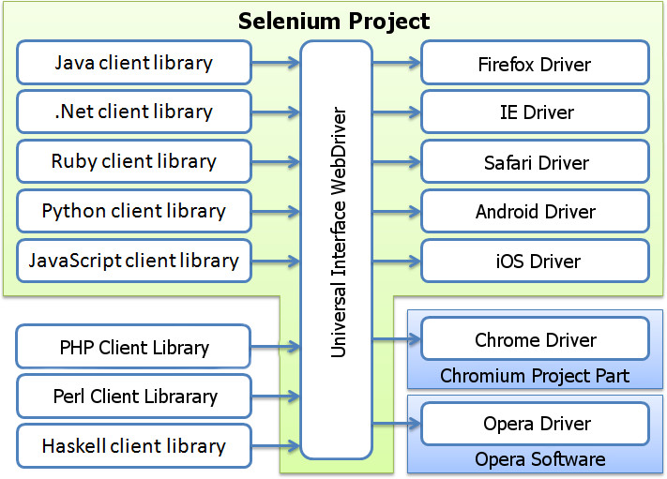
1. WHAT IS WEBDRIVER? DEFINITION
Selenium WebDriver, or Selenium 2.0 (widespread abbreviation - WebDriver) is a software library for browser management.
WebDriver is not a tool for test automation (such as TestComplete, QuickTest Pro, …).

Slide 12
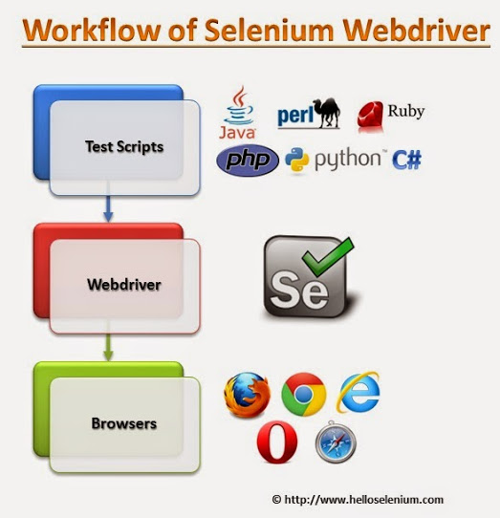
1. WHAT IS WEBDRIVER? WORKFLOW
A automation developer creates a scenario in any high level language (using a corresponding library)
The scenario is accepted by WebDriver and transformed into the language, that a particular browser (depends on WebDriver type) understands
Browser performs the manipulations, that were described in the first step

Slide 13
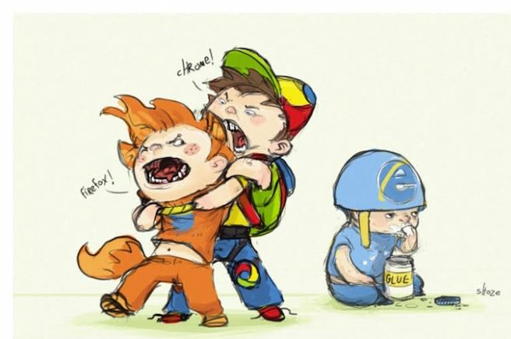
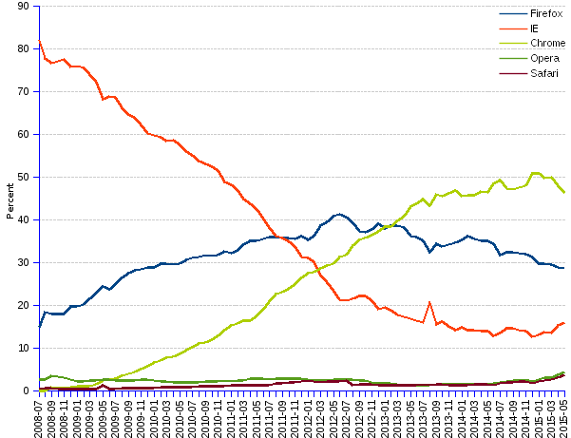
1. SUPPORTED BROWSERS
Wide variety of browsers supported:
Firefox (all the version, where Selenium IDE is available)
IE (7-10, 11 – additional configuration required)
Edge (not all major features yet implemented)
Safari (5.1+)
Opera (Opera Software)
Chrome (Chromium)

Slide 14


1. SUPPORTED PLATFORMS
Windows
Linux
Mac OS
OS X
Solaris
Android
iOS

Slide 15
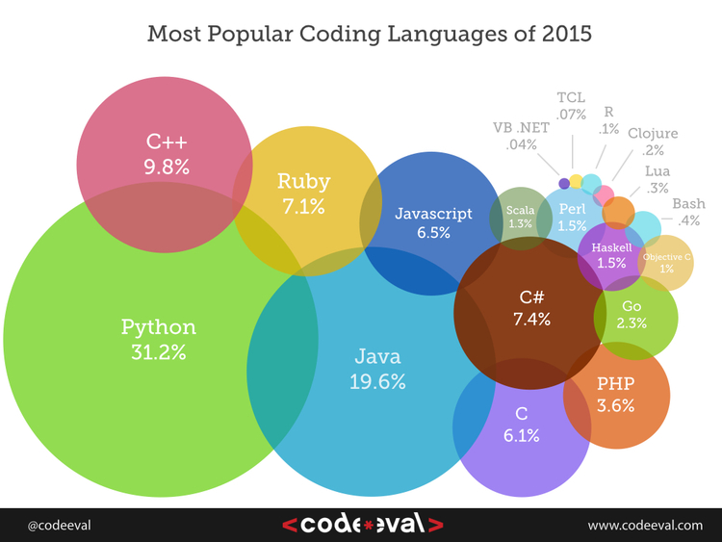
1. SUPPORTED PROGRAMMING LANGUAGES
Programming languages (+ frameworks)
Java (JUnit, TestNG)
JavaScript (WebdriverJS, WebdriverIO, NightwatchJS)
C# (NUnit)
Objective-C
Perl
PHP (Behat + Mink)
Python (unittest, pyunit, py.test, robot framework)
Ruby (RSpec, Test::Unit)

Slide 16
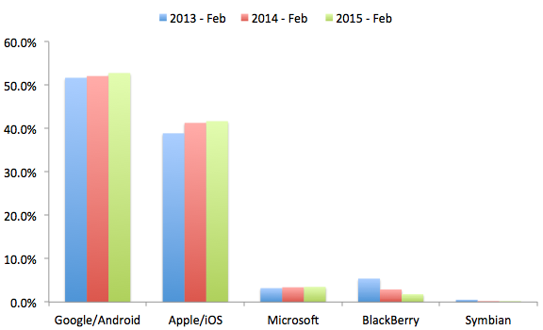
1. WHAT IS WEBDRIVER? MOBILE SUPPORT
Mobile Drivers:
Windows Phone
Selendroid (real Android devices and emulators)
Appium (iOS and WebDriver using WebDriver protocol)
iOs-driver
BlackBerry 10

Slide 17
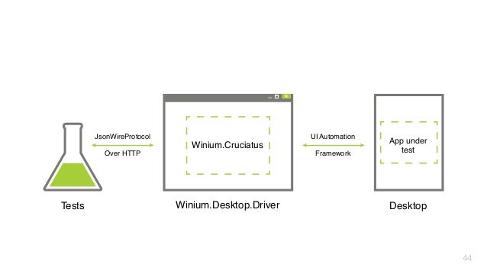
1. WHAT IS WEBDRIVER? WINIUM
Win-desktop + Selenium (http-client)
How to start with Winium:
download the latest driver;
Launch the driver with administrator privileges;
Select your favorite programming language and IDE;
How to get locators:
1) UISpy;
2) UI Automation Verify
(more handy + better performance)
Do not touch your mouse, then a case is started
Locators:
- AutomationProperties.AutomationId
- Name
- ClassName

Slide 18

1. WHAT IS WEBDRIVER? HTMLUNIT DRIVER
The fastest and most lightweight implementation of WebDriver
Java based (for any language binding (other than java) the Selenium Server is required to use this driver)
without a GUI
Pros:
Fastest
Platform independent (pure Java)
Supports JavaScript
Cons:
Emulates other browsers’ JavaScript behavior (Rhino JavaScript engine, that is used by HtmlUnit, is used by none of the popular browsers)
Absence of the visual control (screenshots, etc.)

Slide 19
1. WHAT IS WEBDRIVER? PROS AND CONS
Pros | Cons
Selenium is pure open source, freeware and portable | Require expertise resources, well versed in frameworks
Supports a lot of languages (Java, C#, …) | Difficult to test image based applications
Supports many OS-s and browsers | Needs outside support for report generation
Can be integrated with Maven and ANT build tools | Does not support built in add-ins support
Can be integrated TestNG, NUnit, … | Does not provide any built in IDE
Can be integrated with Jenkins Hudson and other CI tools | Selenium Engineers are bit in scarcity these days
Can be used for mobile testing | Script creation time is bit high
Low CPU and RAM consumption | Partially supports for Dialog boxes
Faster test execution (in comparison with Selenium RC) | Some popular methods are missed - isElementPresent()
Doesn’t require Selenium Server (unlike Selenium RC) | Does not support file upload facility

Slide 20
Part 2
Selenium WebDriver.
How it works?

Slide 21
2. HOW IT WORKS? LAYERS
WebDriver API
WebDriver SPI
JSON
Browser
User API
Service
Links different PL with browsers
Notes:
the API is the description of classes/interfaces/methods/... that you call and use to achieve a goal and
the SPI is the description of classes/interfaces/methods/... that you extend and implement to achieve a goal

Slide 22
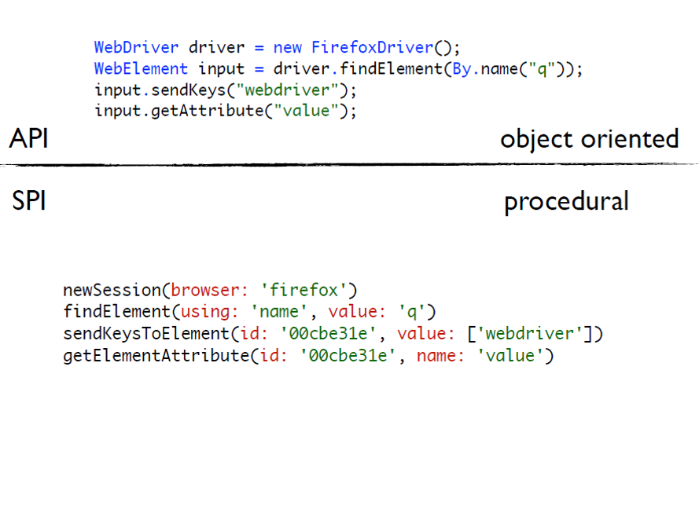
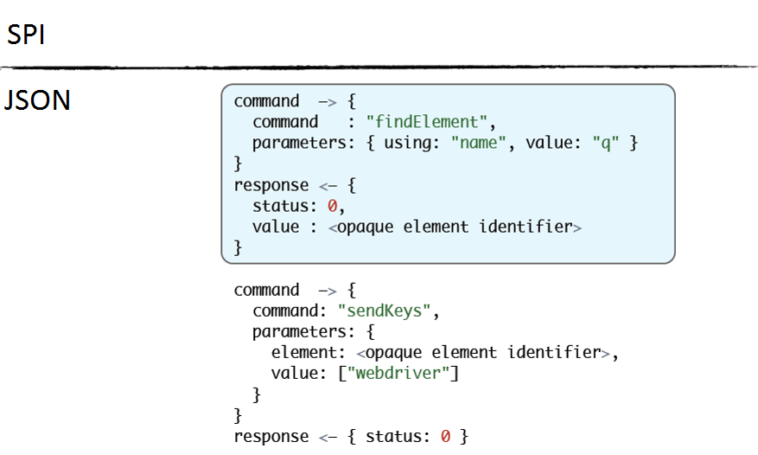
2. HOW IT WORKS? FROM TEST TO BROWSER

Slide 23
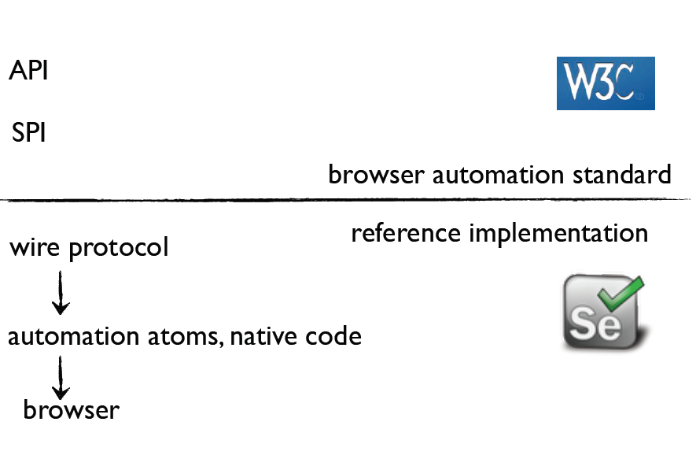
2. HOW IT WORKS? W3C
Notes:
the API is the description of classes/interfaces/methods/... that you call and use to achieve a goal and
the SPI is the description of classes/interfaces/methods/... that you extend and implement to achieve a goal

Slide 24


2. HOW IT WORKS? CORE
Json Wire Protocol (JSWP) is a unified REST-protocol for a test and a test application to interact between themselves.

Slide 25
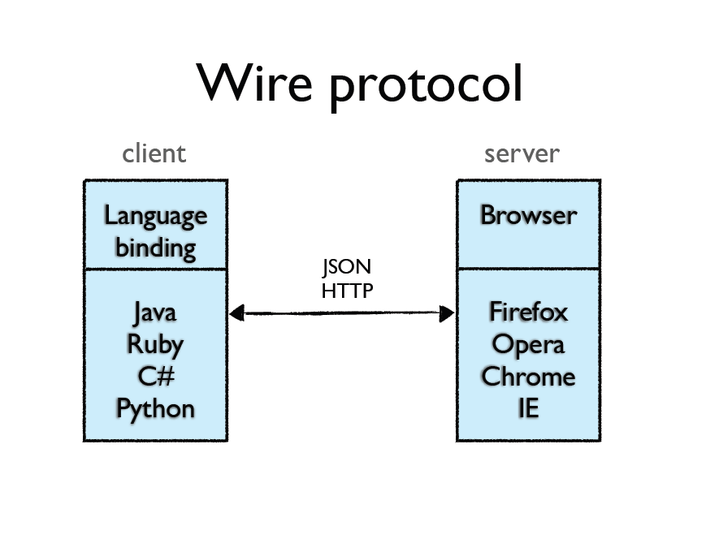
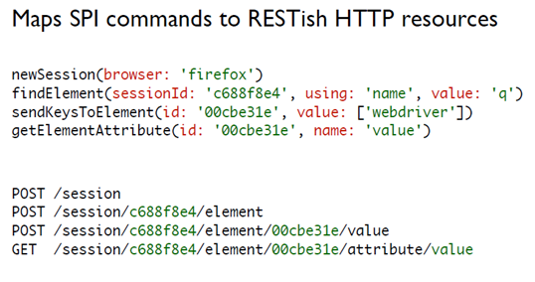
2. HOW IT WORKS? WIRE PROTOCOL

Slide 26
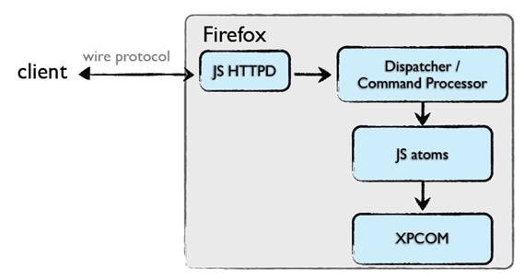
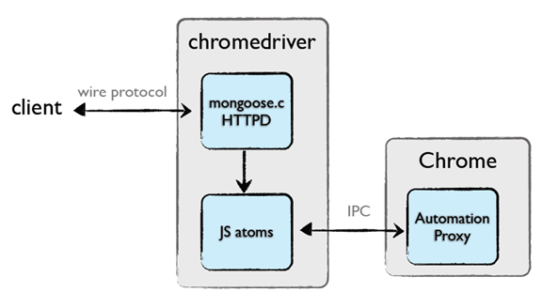
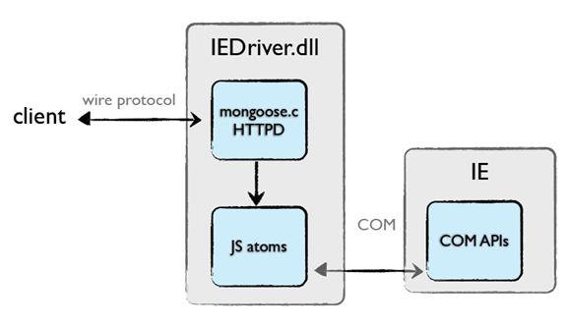
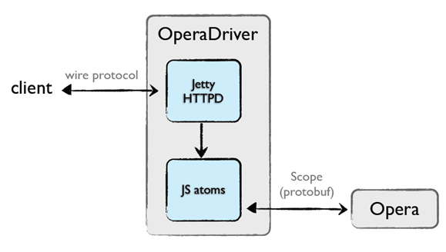
2. HOW IT WORKS? DIFFERENT BROWSERS

Slide 27
Part 3
Selenium WebDriver.
WebDriver API

Slide 28

3. WEBDRIVER API
Interface WebDriver - represents an idealized web browser.
Methods can be used for:
control of the browser itself;
selection of WebElements
debugging aids
Key methods:
get(String url) - to load a new web page
findElement(By by) – to find an element on the page
close()
findElements(By by)
getCurrentUrl()
getPageSource()
getTitle()
getWindowHandle()
getWindowHandles()
manage()
navigate()
quit()
switchTo()

Slide 29
3. WEBDRIVER API
Java | Description
close() | Close current window
findElement(By by) | Find first WebElement By locator
findElements(By by) | Find all WebElements By locator
get(String url) | Open URL
getCurrentUrl() | Get current URL
getPageSource() | Get Page source
getWindowHandle() | Get window descriptor
getWindowHandles() | Get window descriptors
manage() | Managing the WebDriver
navigate() | Navigate backward and forward (History)
quite() | Exit browser
switchTo() | Switch to frame or window
getTitle() | Get current page title

Slide 30
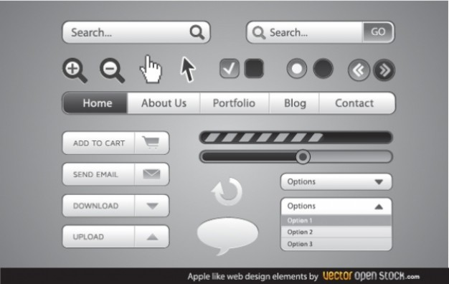
3. WEBDRIVER API. WEBELEMENT
Interface to represent an HTML element
Provides methods to interact with web page elements:
clear()
click()
findElement(By by)
findElements(By by)
getAttribute(String name)
getCssValue(String propertyName)
getLocation()
getSize()
getTagName()
getText()
isDisplayed()
isEnabled()
isSelected()
sendKeys(CharSequence... keysToSend)
submit()

Slide 31
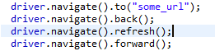
3. WEBDRIVER API. NAVIGATION
Open Page URL
Browser Navigation

Slide 32
Demo

Slide 33
Part 4
Selenium WebDriver.
LOCATORS

Slide 34
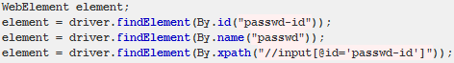
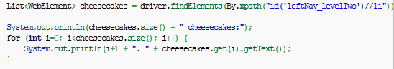
4. LOOKING FOR ELEMENTS
Search for a single WebElement by some criteria
How to search:
Search for a all WebElements by some criteria

Slide 35

3. WEBDRIVER API. BY
By - provides a mechanism to find elements within a document.
Using By class we can find elements via:
ID,
Link Text (also partial),
Name,
Class,
XPath,
CSS Selector,
Tag Name

Slide 36
4. BY CLASS
Java | Description
By.id(String id) | Unique id
By.linkText(String linkText) | Link text
By.name(String name) | Name attribute
By.partialLinkText(String linkText) | Part of link text
By.tagName(String name) | Search by HTML tag
By.xpath(String xpathExpression) | XPATH expression
By.className(Sting name) | CSS class

Slide 37
3. 8 LOCATOR STRATEGIES
Strategy | HTML | Selenium Locator
Identifier | <form id="login"> <input name="username" type="text"/> </form> | identifier=login identifier=username
ID | <form id="login"> | id=login
Name | <input name="username" type="text"/> | name=username
Xpath | <form id="login"> | xpath=//form[@id=‘login’]
Link Text | <a href=“cancel.html”>Cancel</a> | link=Cancel
DOM | <form id="login"> | dom=document.forms[‘loginForm’]
CSS | <form id="login"> | Css=form#loginForm
Tag Name | <form id="login"> | tagName=form

Slide 38

4. LOCATOR CATEGORIES
Structure-based locators: locators that rely on the structure of the page to find elements:
XPath
DOM
CSS
Attributes-based locators: locators that relies on the attributes of the elements to locate them:
Identifier
ID
Name
Link
CSS
Consider this before choosing a locator strategy

Slide 39

4. LOCATORS. XPATH
XPath is a language for addressing parts of an XML document.
provides basic facilities for manipulation of strings, numbers and Booleans
XPath models an XML document as a tree of nodes
relative location path consists of a sequence of one or more location steps separated by “/”
A location step has three parts:
axis - specifies the tree relationship between the nodes selected by the location step and the context node
node test - specifies the node type and expanded-name of the nodes selected by the location step
zero or more predicates - use arbitrary expressions to further refine the set of nodes selected by the location step
/html/body/*/span[@class] (full /child::html/child::body/child::*/child::span[attribute::class])
More examples:
child::para - selects the para element children of the context node
child::* - selects all element children of the context node
child::text() - selects all text node children of the context node

Slide 40
4. LOCATORS. XPATH AXES
Axis Name | Result
ancestor | Select all ancestors (parent, grandparent, etc.) of the current node
attribute | Selects all attributes of the current node
child | Select all children of the current node
following | Selects everything in the document after the closing tag of the current node
following-sibling | Selects all siblings after the current node
preceding | Selects all nodes, that appear before the current node in the document, except ancestors, attribute nodes and namespace nodes
Xpath Expression | Result
//child::node() | Selects all children of the current node
//attribute::name | Selects the name attribute of the current node
//descendant::input | Selects all input descendants of the current node
child::*/child::input | Selects all input grandchildren of the current node

Slide 41
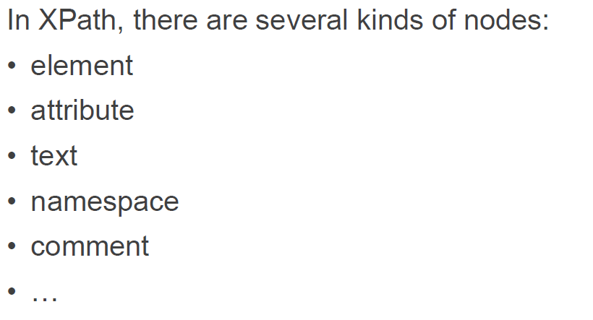
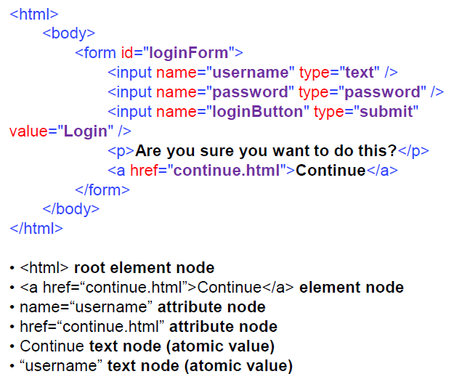
4. LOCATORS. XPATH NODES

Slide 42
4. LOCATORS. XPATH NODES
<?xml version="1.0" encoding="utf-8"?>
<wikimedia>
<projects>
<project name="Wikipedia" launch="2001-01-05">
<editions>
<edition language="English">en.wikipedia.org</edition>
<edition language="German">de.wikipedia.org</edition>
<edition language="French">fr.wikipedia.org</edition>
<edition language="Polish">pl.wikipedia.org</edition>
<edition language="Spanish">es.wikipedia.org</edition>
</editions>
</project>
<project name="Wiktionary" launch="2002-12-12">
<editions>
<edition language="English">en.wiktionary.org</edition>
<edition language="French">fr.wiktionary.org</edition>
<edition language="Vietnamese">vi.wiktionary.org</edition>
<edition language="Turkish">tr.wiktionary.org</edition>
<edition language="Spanish">es.wiktionary.org</edition>
</editions>
</project>
</projects>
</wikimedia>

Slide 43
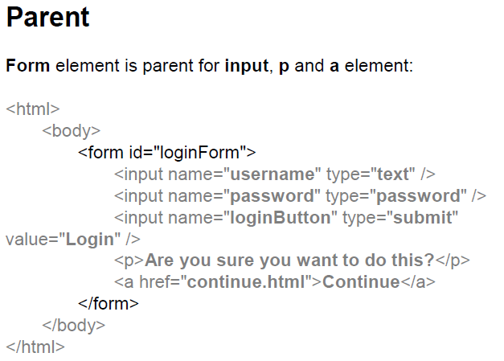
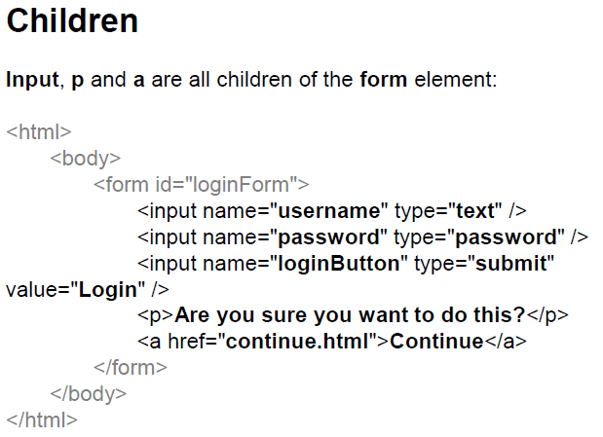
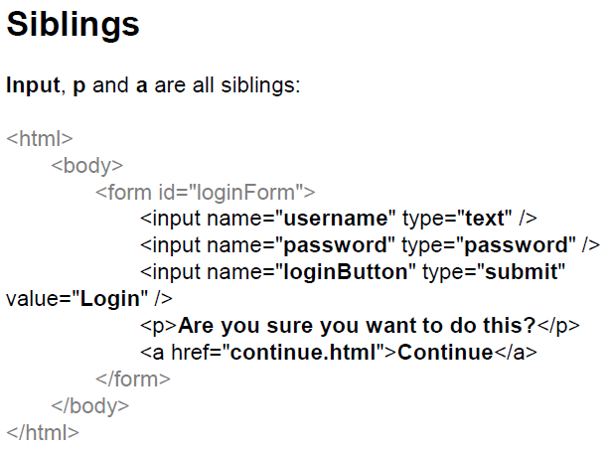
4. LOCATORS. RELATIONSHIPS IN NODES

Slide 44
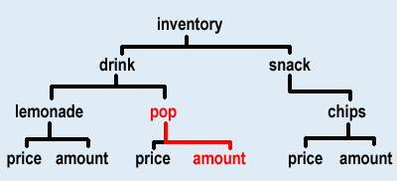
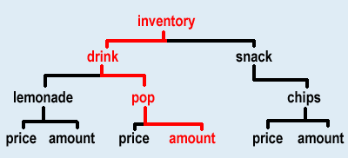
4. LOCATORS. RELATIONSHIPS IN NODES
<inventory>
<drink>
<lemonade>
<price>$2.50</price>
<amount>20</amount>
</lemonade>
<pop>
<price>$1.50</price>
<amount>10</amount>
</pop>
</drink>
<snack>
<chips>
<price>$4.50</price>
<amount>60</amount>
</chips>
</snack>
</inventory>
Pop is the ancestor of amount because pop contains amount
The root element of an XML document is the ancestor of every element in the document.

Slide 45
4. LOCATORS. SELECTING NODES
Expression | Description
nodename | Selects all nodes with the name "nodename"
/ | Selects from the root node
// | Selects nodes in the document from the current node that match the selection no matter where they are
. | Selects the current node
.. | Selects the parent of the current node
@ | Selects attributes
XPath Expression | Result
bookstore | Selects all nodes with the name "bookstore"
/bookstore | Selects the root element bookstoreNote: If the path starts with a slash ( / ) it always represents an absolute path to an element!
bookstore/book | Selects all book elements that are children of bookstore
//book | Selects all book elements no matter where they are in the document
bookstore//book | Selects all book elements that are descendant of the bookstore element, no matter where they are under the bookstore element
//@lang | Selects all attributes that are named lang

Slide 46
4. LOCATORS. SELECTING UNKNOWN NODES
Xpath Expression | Result
form/* | Selects all the child nodes of the form element
//* | Selects all the elements in the document
//input[@*] | Selects all input elements, that have any attribute
//[@*] | Selects all elements, that have any attribute
node() | Matches any node of any kind

Slide 47
4. LOCATORS. XPATH FUNCTIONS
Node-Set (node, document, id…)
String (text, name…)
Boolean (contains, not, true…)
Number (count, position, string-length round, sum…)
Function Example | Results
//format/text() | Selects all text node children of the form element
string-length(//form/p/text()) | Returns the number of characters in the string
contains(text(), ‘sure’) | Returns true if text() contains ‘sure’
count(//input) | Return the number of nodes in the node-set argument

Slide 48
4. LOCATORS. PREDICATES
Predicates are used to find a specific node or a node, that contains a specific value
XPath Expression | Result
//input[2] | Selects the second input element
//input[last()] | Selects the last input element
//form/input[position()<3] | Selects the first two input elements, that are children of the form element
//input[@name] | Selects all the input elements, that have an attribute named name
//input[@type=‘Submit’] | Selects all the input elements, that have an attribute named type with a value of ‘Submit’

Slide 49
4. LOCATORS. XPATH EXAMPLES
XPath | Result
//a[contains(@href, ‘continue’)] | Selects all a elements, that have href attribute with value ‘continue’
//input[not(@type=‘submit’)] | Selects all input elements, that don’t have type attribute with value ‘submit’
//parent::form | Selects all form elements, that are parents for any element
//a/attribute::* | Selects all attributes of the all a elements
//input[1]/ancestor::node() | Selects all ancestors of the first input element
//body/descendant::* | Selects all descendants of the body elements

Slide 50
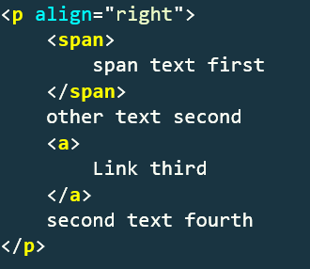
4. LOCATORS. XPATH EXAMPLES
//a[text()=‘Link third'] – OK (a)
//a[text()=‘Link third']/.. – OK (p)
//a[contains(text(),’third’)] – OK (a)
//p[contains(a/text(),’third’)] – OK (p)
//span[contains(.,’first’)] – OK (span)
//p[contains(.,’first’)] – OK (p)
//p[contains(text(),’first’)] – Bad
//p[contains(./a/text(),‘third')] – OK (p)
//p[contains(text(),’second’)] – OK (p)
//p[contains(text(),’fourth’)] – Bad
//p[contains(.,‘Link')][@align='right'] - OK (p)
//p[contains(.,‘Link') and @align='right'] – OK (p)
//p[contains(.,'O_o') or @align='right'] – OK (p)
//p[contains(.,'O_o') or @align=‘left'] - Bad

Slide 51
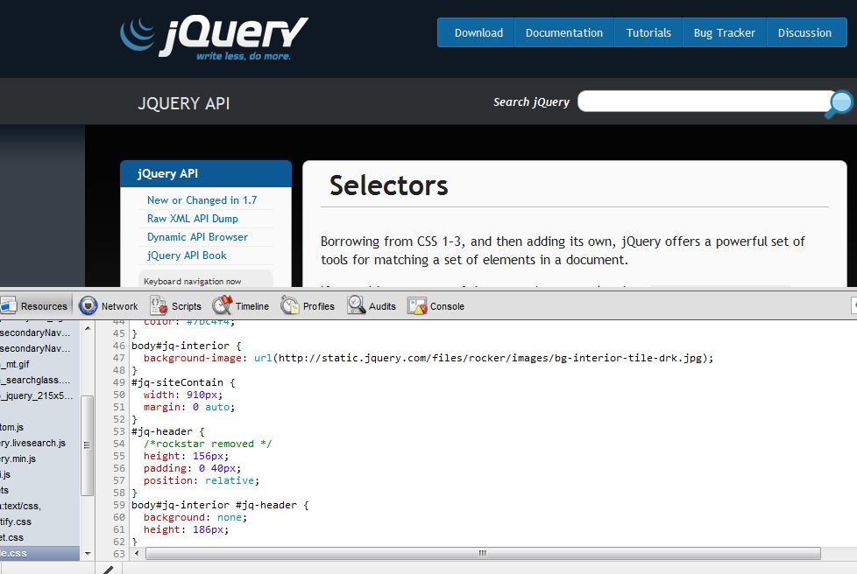
4. LOCATORS. CSS LOCATORS
CSS Selectors

Slide 52
4. LOCATORS. CSS LOCATORS
Expression | Description
E[foo] | E element with a “foo” attribute
E[foo=“bar”] | E element, whose “foo” attribute values is exactly equals to “bar”
E[foo*=“bar”] | E element, whose “foo” attribute value contains the substring “bar”
E.warning | E element with class “warning”
E#messageID | E element with ID ‘messageID’
E F | F element descendant of E element
E > F | F element child of E element
E + F | F element immediately preceded by E element
E, F | E or F element

Slide 53
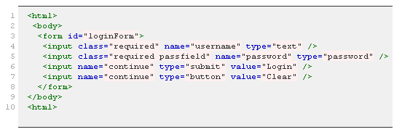
4. LOCATORS. CSS LOCATORS
form#loginForm (3)
input[name="username"] (4)
input.required[type="text"] (4)
input.passfield (5)
#loginForm input[type="button"] (7)
#loginForm input:nth-child(2) (5)

Slide 54
4. LOCATORS. CSS LOCATORS
p – OK (p)
p span – OK (span)
p > a – OK (a)
p span + a – OK (a)
p span ~ a – OK (a)
p ~ a – Bad
p:contains(‘Link') – OK (p)
a:contains(‘Link') – OK (a)
p:contains(‘Link') > a – OK (a)
Working with attributes:
p[align]
p[align=‘right’]
p[align~=‘right’]
p[align$=‘ht’]
p[align^=‘ri’]
p[align*=‘igh’]
p[align^='r'][align$='t']

Slide 55
EXAMPLES. WEBDRIVER API + LOCATORS
void sendKeys(String text) / SendKeys(String text) – Entering text
element.sendKeys("sometext");
element.sendKeys("sometext", Keys.ARROW_DOWN);
void clear() / Clear() – clear content
String getAttribute(String attributeName) / GetAttribute(String attributeName) – getting attribute
void click() / Click() – clicking on element

Slide 56
Demo

Slide 57
Part 5
Selenium WebDriver
Synchronization

Slide 58
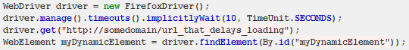
5. SYNCHRONIZATION
Implicit wait

Slide 59
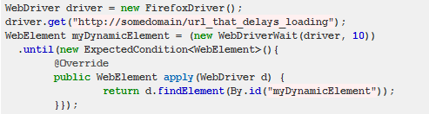
5. SYNCHRONIZATION
Explicit wait

Slide 60
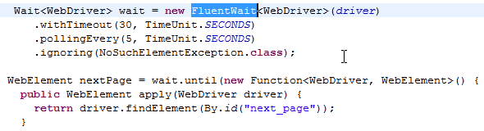
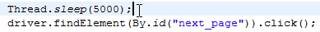
5. SYNCHRONIZATION
User wait
Thread.sleep(timeout)

Slide 61
Demo

Slide 62
Part 6
Selenium WebDriver
Specials

Slide 63
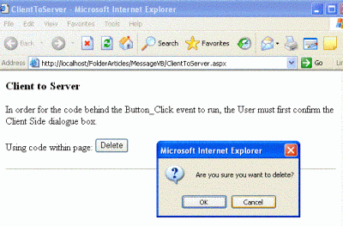
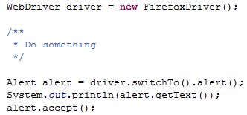
6. SPECIALS. POPUP WINDOWS

Slide 64
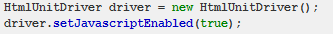
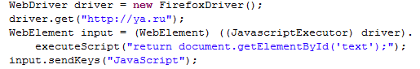
6. SPECIALS. JAVASCRIPT
Enabling JavaScript
JavaScript usage

Slide 65
6. SPECIALS. SELECT
Working with Lists:
WebElement select = driver.findElement(By.id("gender"));
List<WebElement> options = select.findElements(By.tagName("Male"));
for (WebElement option : options) {
if("Germany".equals(option.getText()))
option.click();
}
import org.openqa.selenium.support.ui.Select;
new Select(driver.findElement(By.id("gender"))).selectByVisibleText("Germany");

Slide 66
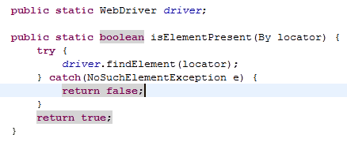
6. SPECIALS. ISELEMENTPRESENT()
One of isElementPresent() implementations
return driver.findElements(By(locator)).size() > 0;

Slide 67
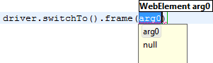
6. SPECIALS. FRAMES
Frame – element we can find by locator
Get back to root content

Slide 68
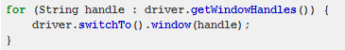
6. SPECIALS. WORK WITH WINDOWS

Slide 69

SELENIUM WEBDRIVER. LECTURE 1. SUMMARY
Selenium is an open source project
WebDriver is a library for browser management (main product under Selenium)
Selenium IDE is a Firefox extension for simple test record and playback
There are driver for all popular browsers and mobile platforms
WebDriver 2.0 (Selenium 3.0) will be a standard interface to control a browser (coming soon)
WebDriver API is easy and clear (13 methods)
There are 8 locator strategies (every has its pros and cons – select the best for your project)
Locator can be get with Xpath or CSS. Use your own judgement
WebDriver supports explicit and implicit waits
There are some tricky things with synchronization and windows/popups/frames handling

Slide 70
RESOURCES ABOUT WEBDRIVER
http://seleniumhq.org/projects/webdriver/ - official WebDriver definition
http://seleniumhq.org/download/ - download page for components
https://github.com/seleniumhq/selenium - alternative source
http://seleniumhq.org/docs/03_webdriver.html - basic information about Selenium WebDriver
http://toolsqa.com/selenium-webdriver/ - well supported and structured resource about automation via WebDriver. Contains many best practices.

Slide 71
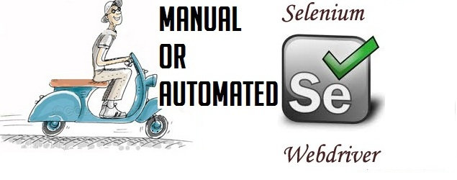
HOME TASK
Create automated tests for the AUT using WebDriver + Java + TestNG

Slide 72
Thanks for attention.
Questions?

